Slide 1

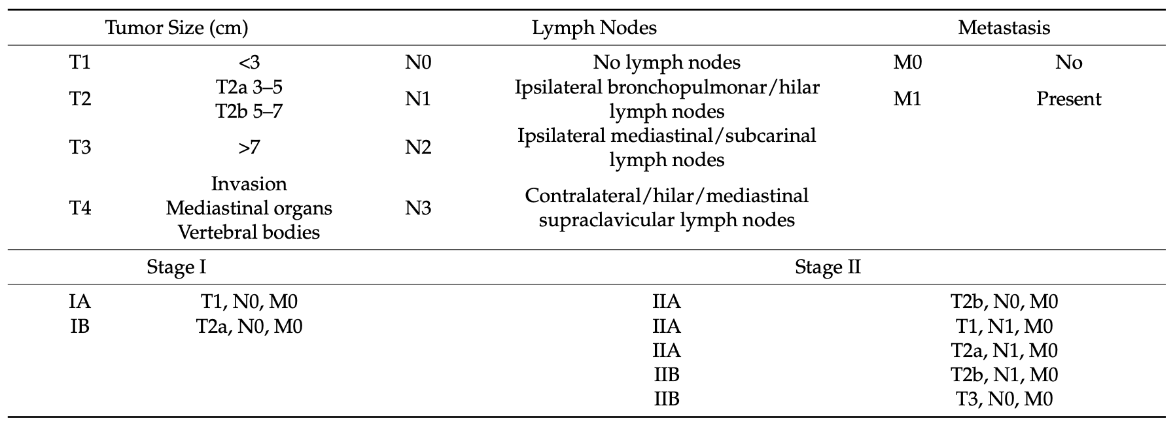
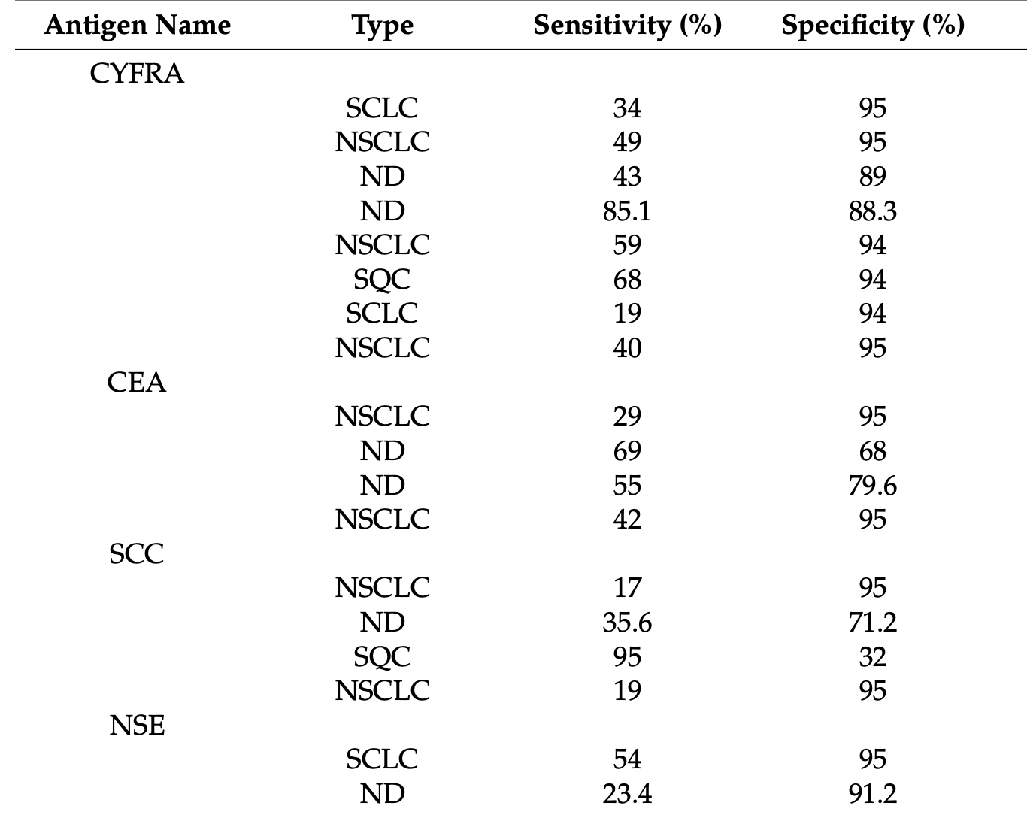
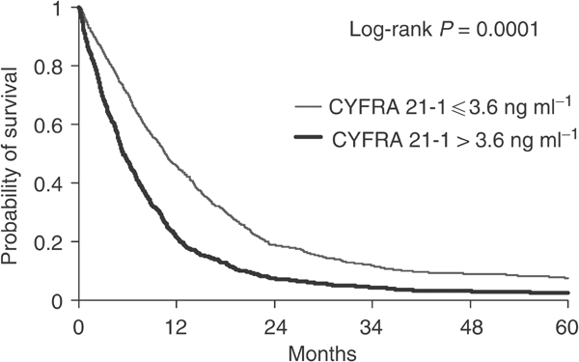
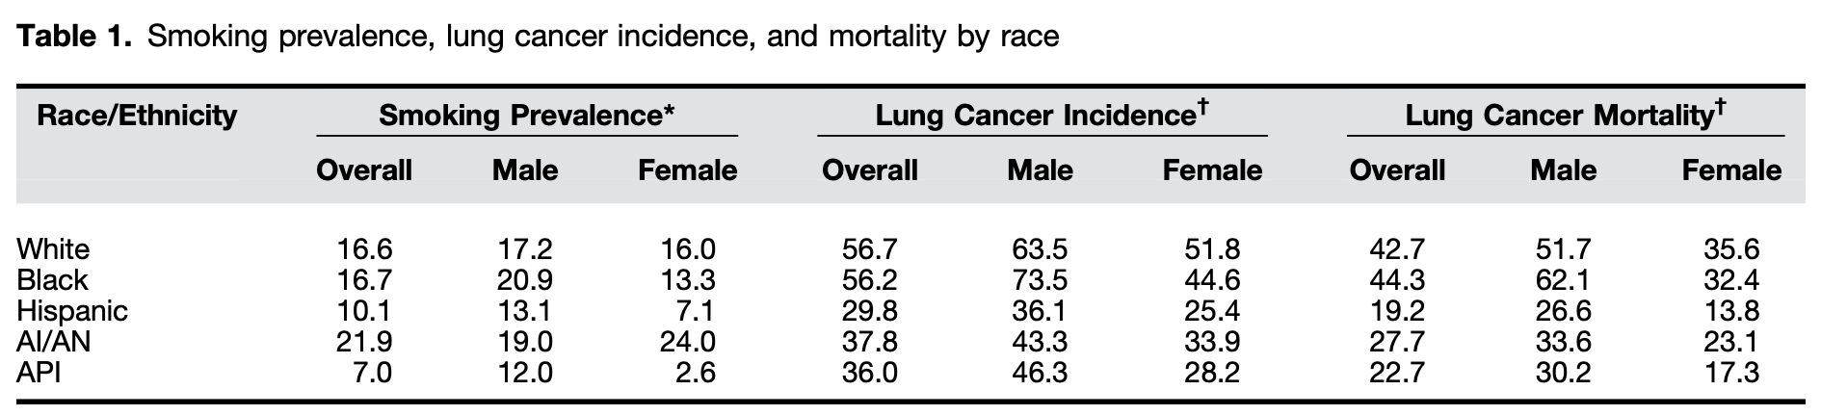
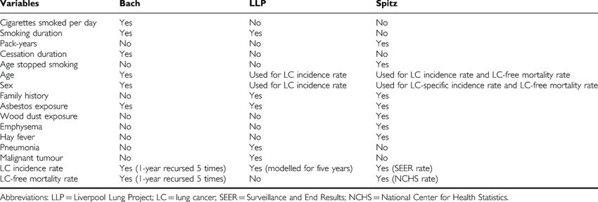
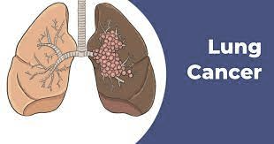
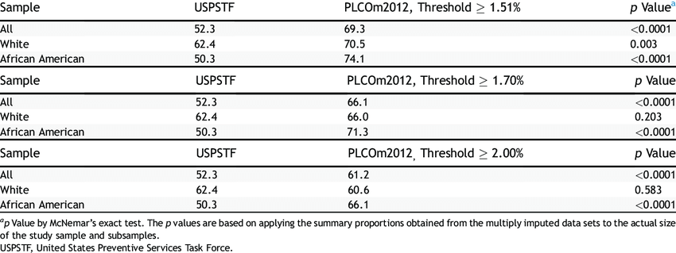
Current and Future Development in
Lung Cancer Diagnosis
Author: Jiao Yihang
Abstract
Materials and Methods
Results
Lung cancer is the leading cause of cancer-related deaths all over the world. One of the reasons lung cancer is at the top of the list is that it is often not diagnosed until the cancer is at an advanced stage. Based on the current knowledge, it looks that there is an urgent need to identify novel biomarkers. The current diagnosis of lung cancer includes different types of imaging complemented with pathological assessment of biopsies, but these techniques can still not detect early lung cancer developments.
In our research, we explored current methods used in diagnosing lung cancer, and we tried to classify patients into different groups to give better treatment
Lung Tissue Biopsies
Lung Cancer Classification
NSCLC : using biomarkers in early diagnosis and follow-up of a treatment and even choosing a treatment protocol
Lung Tissue Biopsies: Bridging between Traditional and New Screening Methods. Costly, prone to complications, and a possible need for more sample
Table 1. TNM of malignant tumor classification.
Introduction
Transition to Biomarker Applications
Introduction
The earliest diagnosis of lung cancer is crucial, especially in screening high-risk populations with an urgent need to identify novel biomarkers. Accurate diagnosis is vital for the most suitable treatment of individual patients with lung cancer. Thus, there is an urgent need to identify sensitive and specific biomarkers for early diagnosis.
Table 4. Sensitivity and specificity analysis of common antigens found in lung cancer.
Figure 1. Probability of survival of non-small-cell lung cancer patients with normal and elevated pretreatment serum CYFRA 21-1 level; Kaplan–Meier curves were constructed taking into account the whole population survival.
Disparities Factors
Disparities Factors
This study will focus on 2 questions:
How to improve earliest diagnosis of lung cancer?
How to apply accurate diagnosis, suitable treatment of individual patients with lung cancer?
Race and Ethnicity
Table 5. Smoke prevalence, lung cancer incidence and mortality by race
Conclusions
The trend of developing more reliable tests for early diagnosis of lung cancer :Should focus on biomarker discovery that will alleviate the discomfort of the patients and the burden for the health authorities
Table 2. Smoke prevalence, lung cancer incidence and mortality by race
Materials and Methods
Environmental and Occupational Exposures
Racial differences in smoking behaviors, lung cancer incidence, age at presentation, and mortality: should be considered
Lung Cancer Classification
Outcomes for high-risk individuals and patients with lung cancer will equalize once disparities in lung cancer screening eligibility and access to care are considered.
NSCLC
Based on the detection of biomarkers provided a channel for subgrouping patients.
Serves as a model for the successful application of “precision medicine” or the concept of using advanced genetic analysis of a patient’s tumor to obtain an individualized therapy plan
Professional organizations caring for patients with lung cancer to be addressed the disparities discussed in this review and translate them into actionable policy recommendations.
Table 3. Sensitivity (%) of the USPSTF Criteria Versus the PLCOm2012 Risk Prediction Model With Varying Thresholds for Positivity Stratified by Race
Reference
Mercer, R. Canadian Cancer Statistics: A 2020 Special Report on Lung Cancer; Canadian Centre for Applied Research in Cancer Control: Vancouver, BC, Canada, 2020.
Horeweg, N.; Scholten, E.T.; de Jong, P.A.; van der Aalst, C.M.; Weenink, C.; Lammers, J.-W.J.; Nackaerts, K.; Vliegenthart, R.; ten Haaf, K.; Yousaf-Khan, U.A.; et al. Detection of Lung Cancer through Low-Dose CT Screening (NELSON): A Prespecified Analysis of Screening Test Performance and Interval Cancers. Lancet Oncol. 2014, 15, 1342–1350. [CrossRef]

